Slide 1
Working with Collection, Generic Delegates and Event
Do Quoc Binh

Slide 2
Generic
Generics allow you to write general-purpose code that’s type safe at compile time.
When generics were first introduced, their primary use was for collections, but in modern C# code, they crop up everywhere.
They’re probably most heavily used for the following:
Collections (they’re just as useful in collections as they ever were)
Delegates, particularly in LINQ
Asynchronous code, where a Task<T> is a promise of a future value of type T
Nullable value types

Slide 3
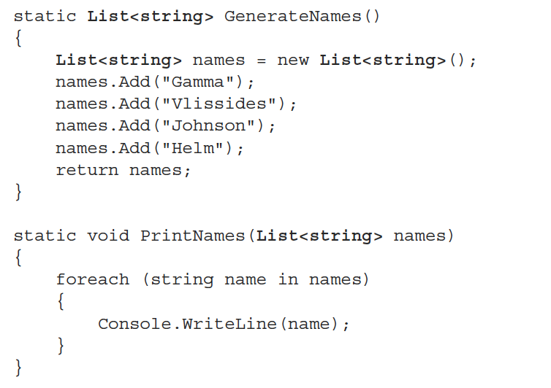
Example of Generic

Slide 4
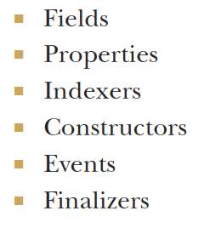
What can be generic?

Slide 5
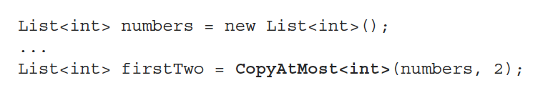
Example of Generic method

Slide 6
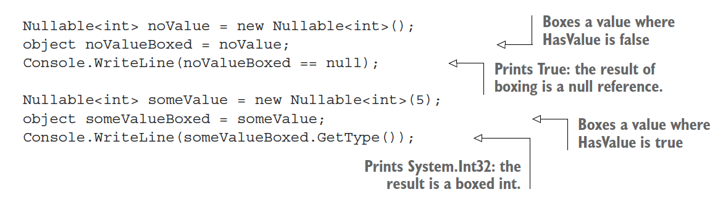
The Nullable<T> struct
T to be any value type
except another Nullable<T>

Slide 7
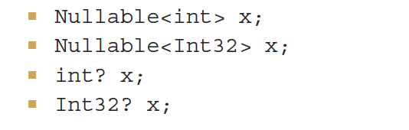
THE ? TYPE SUFFIX
If you add a ? to the end of the name of a non-nullable value type, that’s precisely equivalent to using Nullable<T> for the same type
For example, these four declarations are precisely equivalent

Slide 8

Delegate
A Delegate is similar to a function pointer (functor) in C and C++.
Delegates describe the signature of a method (parameter and return types)

Slide 9
Evolution of Delegates in C#
C# 1.0: Named Delegates
C# 2.0: Anonymous Methods
C# 3.0: Lambda Expression

Slide 10
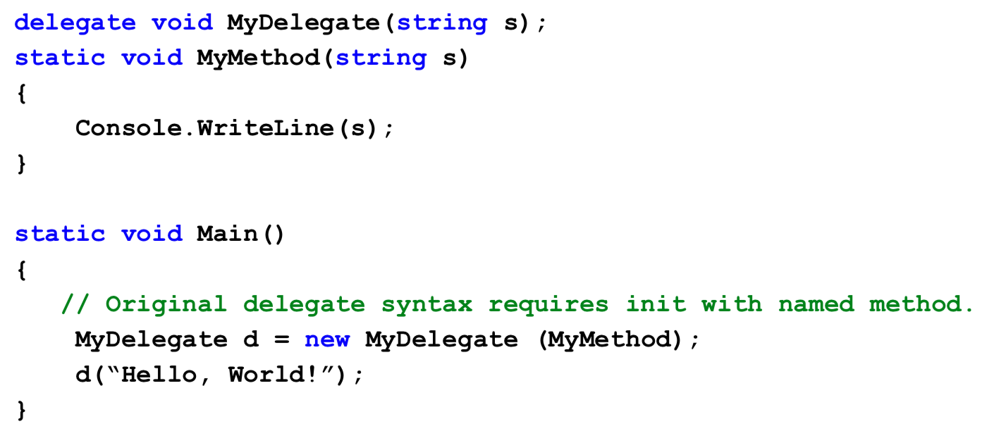
C# 1.0: Named Delegate

Slide 11
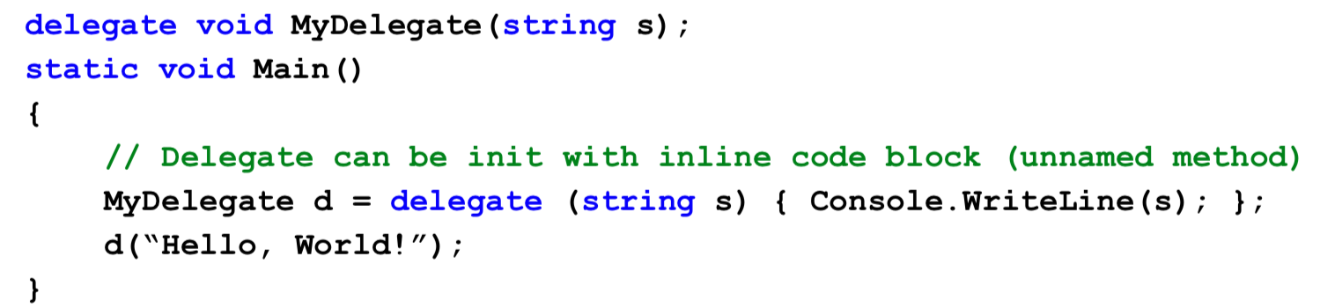
C# 2.0: Anonymous Method

Slide 12
There ae two fundamental types of Lambdas:
Statement Lambdas: just a shorter version of a C# 2.0 anonymous method (code block), do not return values
Expression Lambdas: return a value. (Predicate Lambdas are Expression Lambdas where the return value is simply true or false.)

Slide 13
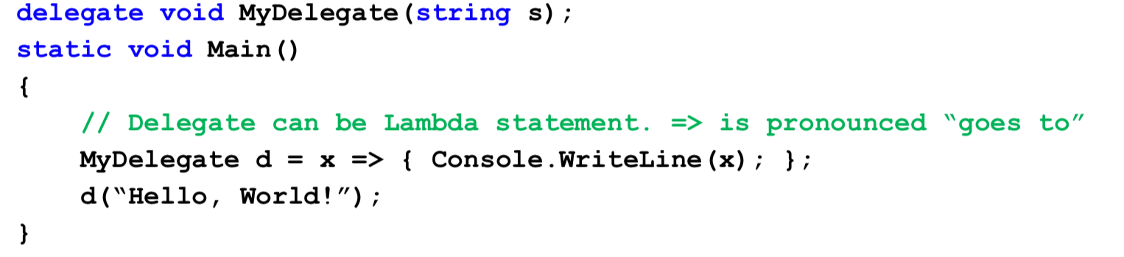
C# 3.0 Lambda
is often pronounced “goes to”

Slide 14
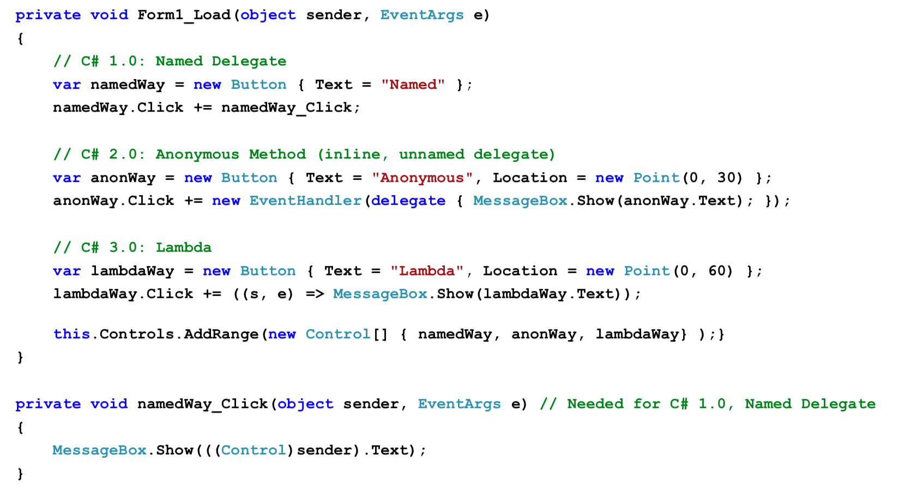
Delegate and EventHandler

Slide 15
C# Lambda Syntax
Lambdas are a simpler way to express anonymous delegates
Although parameter types can be specified explicitly, they are usually left out (inferred).
Parameter names are arbitrary. (Since the parameter types are often omitted as well, the names simply just appear.)

Slide 16
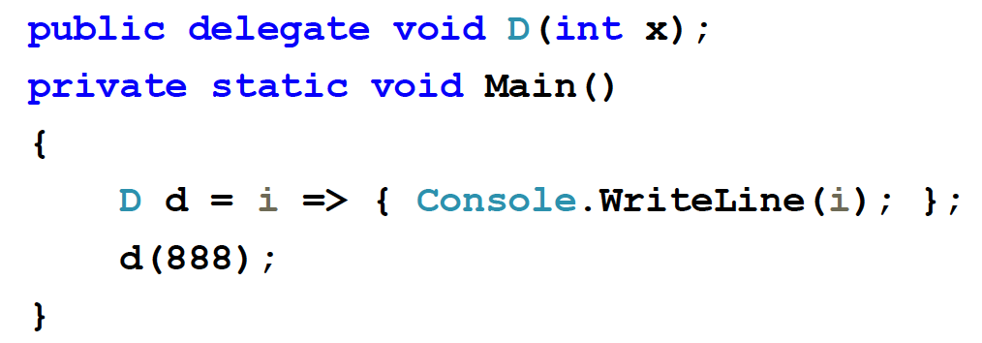
Lambda Statement with one argument

Slide 17
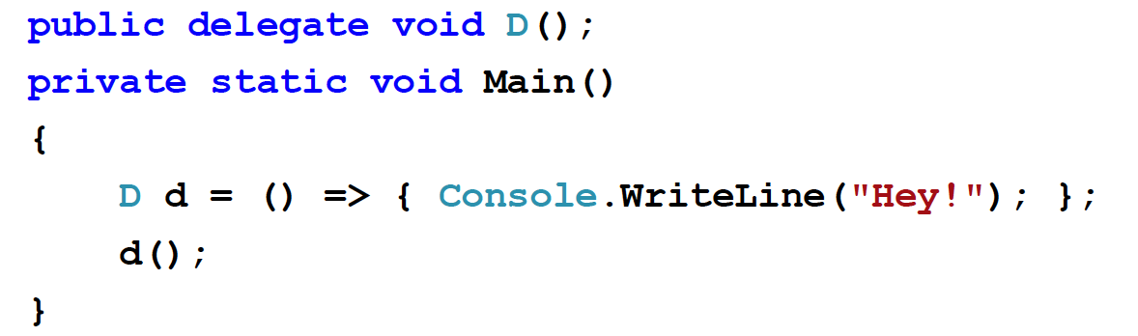
Lambda Statement with no arguments

Slide 18
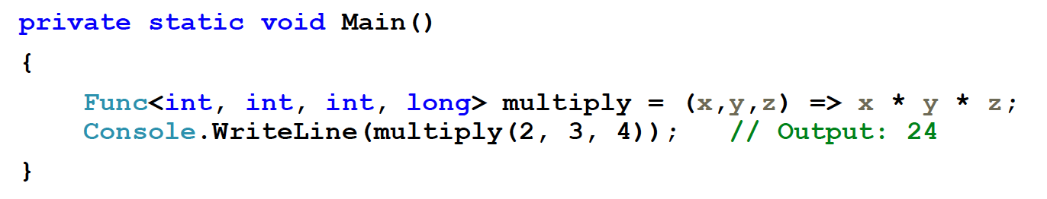
Using the pre‐defined Func delegate shortcut (.Net 3.5)

Slide 19
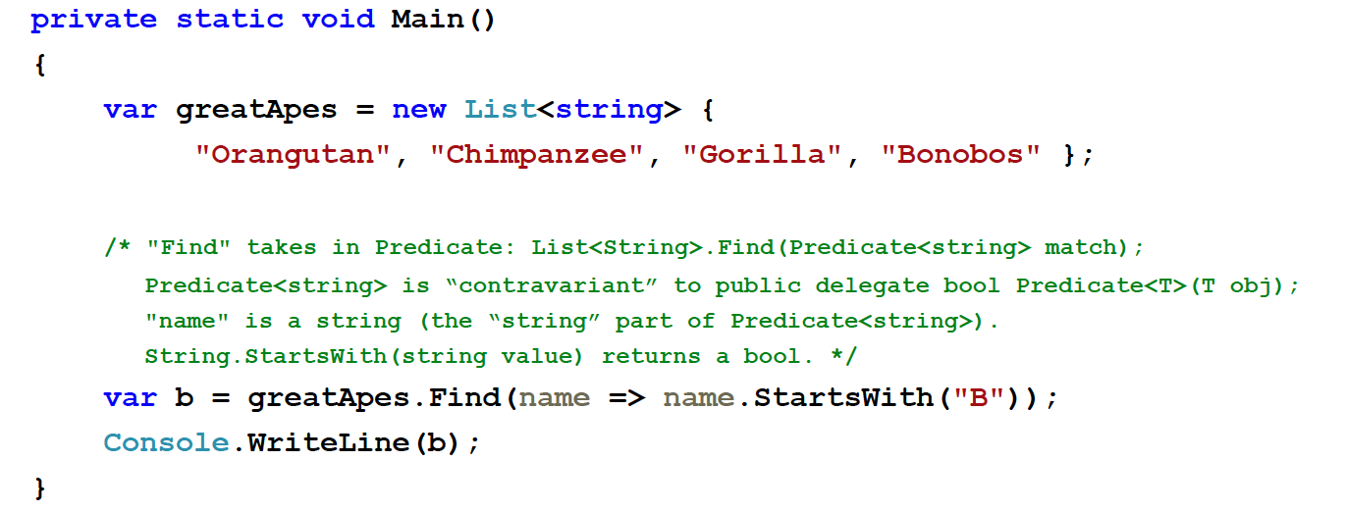
Lambda with LINQ

Slide 20
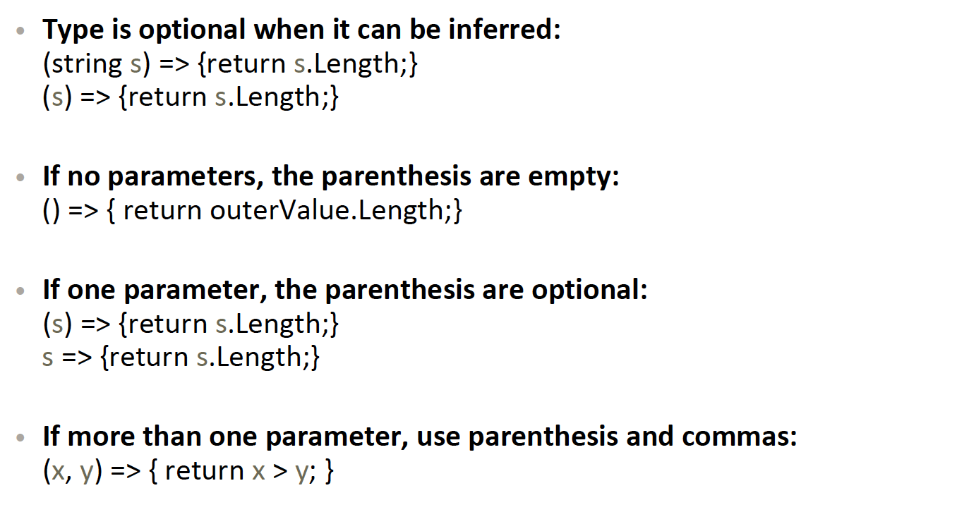
Lambda Parameters

Slide 21
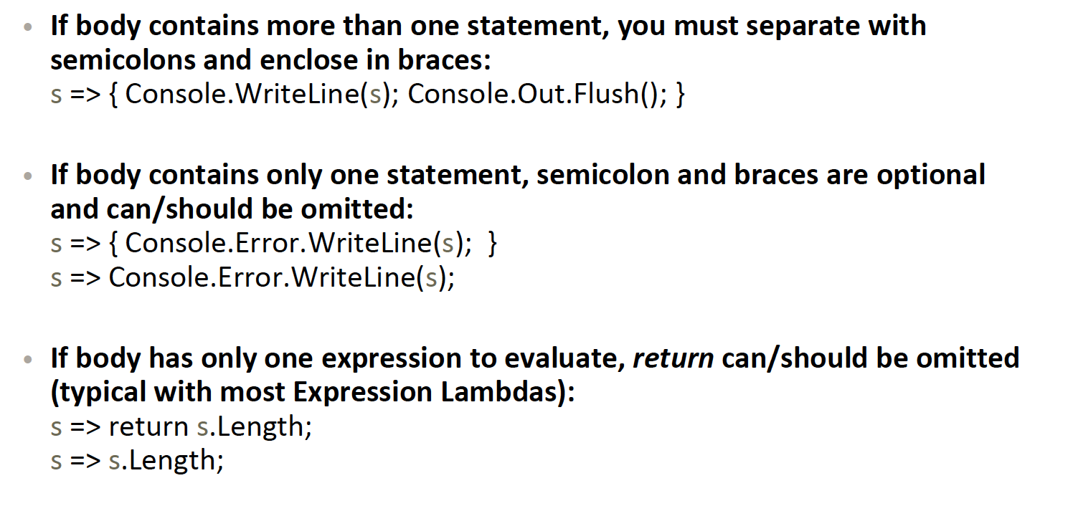
Lambda Bodies

Slide 22
Delegates and lambdas
.NET includes a set of delegate types that programmers can reuse and not have to create new types
Action<> is used when there is a need to perform an action using the arguments of the delegate.
Func<> is used usually when you have a transformation on hand, that is, you need to transform the arguments of the delegate into a different result. Projections are a prime example of this
Predicate<> is used when you need to determine if the argument satisfies the condition of the delegate. It can also be written as a Func<T, bool>.

Slide 23
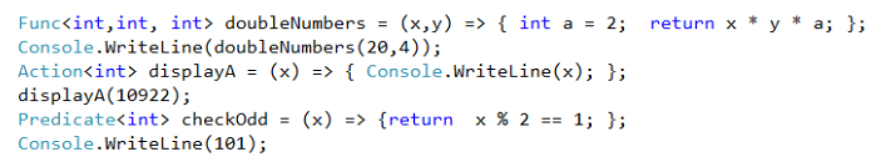
Do it your self: check the descriptions which suggested by VS

Slide 24
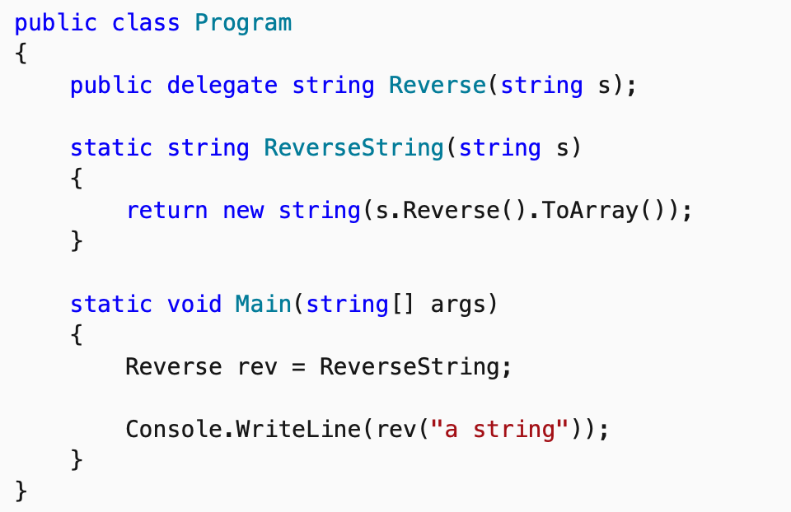
Without no pre-defined delegate
Declare a Delegate

Slide 25
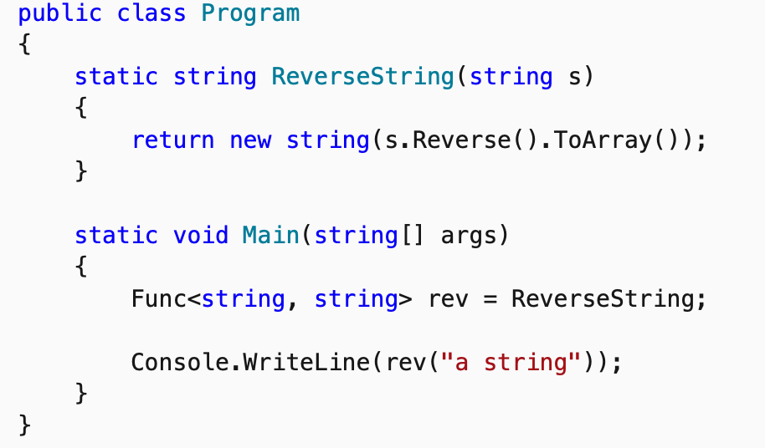
With pre defined- delegate
But wait!
having a method defined outside of the Main method seems a bit superfluous.
Func<string, string> delegate

Slide 26
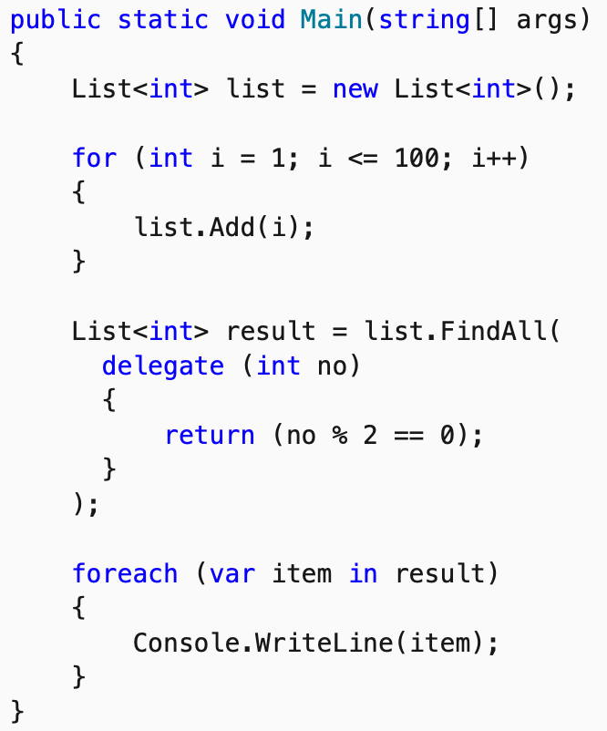
NET Framework 2.0 of anonymous delegates
Anonymous delegates

Slide 27
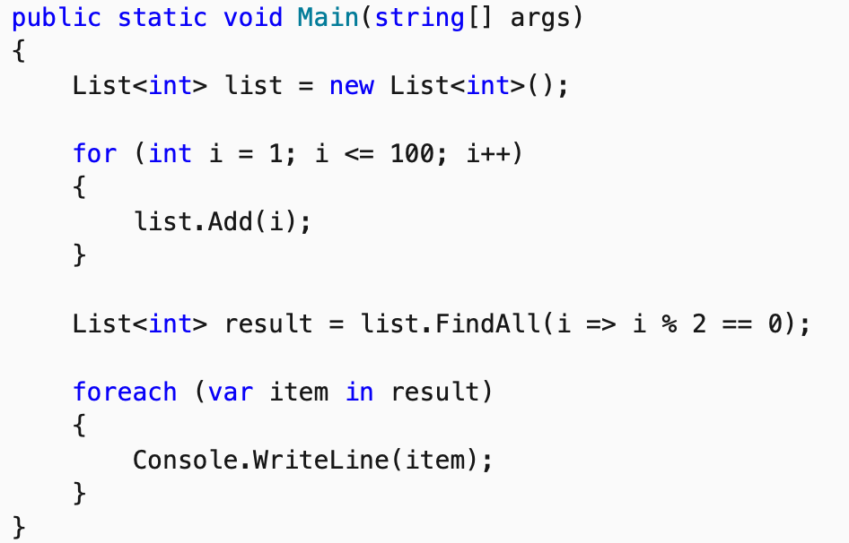
Lambda expression is just another way of specifying a delegate
Should be able to rewrite the above sample to use a lambda expression instead of an anonymous delegate?

Slide 28
Event in C#
Events in .NET are based on the delegate model
The delegate model follows the observer design pattern, which enables a subscriber to register with and receive notifications from a provider
An event sender pushes a notification that an event has happened
An event receiver receives that notification and defines a response to it

Slide 29
Event example
Click event is a member of the Button class
PropertyChanged event is a member of the class that implements the INotifyPropertyChanged interface.

Slide 30
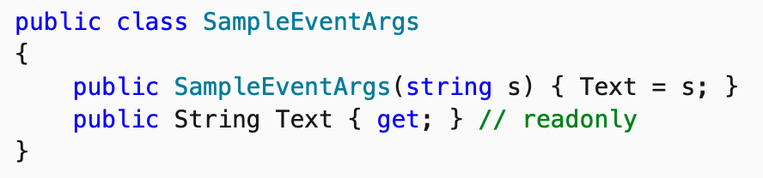
Example- Define a event argument

Slide 31
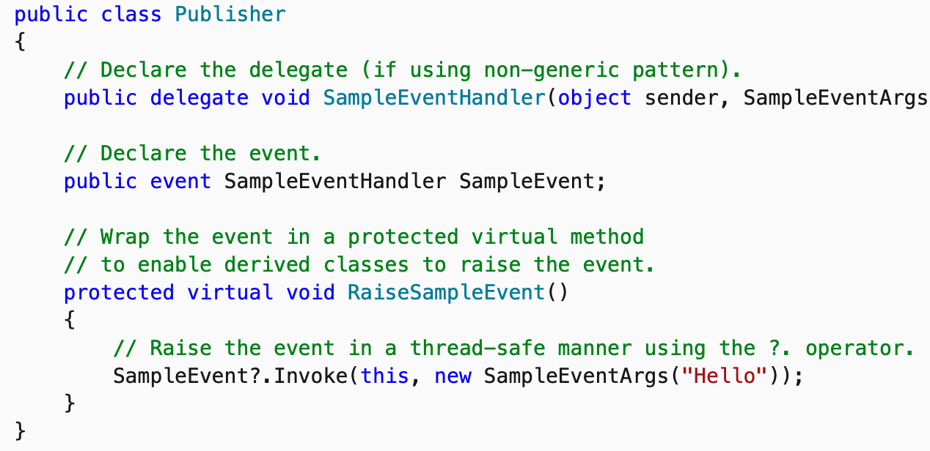
Example: define a class which has an event

Slide 32
Static event
An event may be declared as a static event by using the static keyword. This makes the event available to callers at any time, even if no instance of the class exists

